Slide 1
LECTURE 2
THE USES OF TEXT IN MULTIMEDIA
Prepared by
Razia Nisar Noorani
Notes:
SCA3103 - Introduction to Multimedia
Sesi 2003/04 Sem II
Lecture 4

Slide 2
Objective
Media Types
What text is
How text is created and stored in the computer
How text is used in Multimedia Systems
Advantages and Disadvantages
of using texts

Slide 3
Temporal & Non Temporal Media
Media
Refer to Multimedia elements.
Two Media types:Temporal and Non-Temporal
Temporal Media
The media has an associated time aspect. Example: its view changes with respect to time.
Examples: Audio, video, animation, music etc.

Slide 4
Temporal & Non Temporal Media
Non-Temporal Media
Also known as a static media. It has the same representation regardless of time
Examples: texts, graphics, paintings, book etc
Multimedia applications are typically composed of both media

Slide 5
What is Text
Basic media for many multimedia systems
Texts in the form of words, sentences and paragraphs is used to communicate thoughts, ideas and facts in nearly every aspect of our lives.
Multimedia products depends on text for many things:
- to explain how the application work
- to guide the user in navigating through the application
- deliver the information for which the application was
designed

Slide 6
What is Text
Minimize the texts in multimedia application
Texts consists of two structures:
  Linear
  Non-Linear

Slide 7
Text Technology
Based on creating letters, numbers and special characters.
Text elements can be categories into:
  Alphabet characters : A - Z
  Numbers : 0 - 9
  Special characters : Punctuation [. , ; ‘ …] , Sign or Symbols [* & ^ % $ £ ! /\ ~ # @ .…]
  Also known Character Sets
May also include special icon or drawing symbols, mathematical symbols, Greek Letter etc.

Slide 8
Typefaces, Fonts and Points
Typefaces
The graphic representations of the alphabet, numbers and special character.
Usually vary by type sizes and styles.
Fonts
Particular size of typefaces
Usually vary by type sizes and styles.
The sizes are measured in points
  - One point is 1/72” or 0.0138 inc”
  Measuring distance from the top of a capital letters (e.g. ‘A or P’) to the
  bottom of a descenders (e.g. ‘y , ‘p’ , ‘q’).

Slide 9
Fonts Effects
A numbers of effects that are useful for bringing viewer’s attention to content:
  Case: UPPER and lower letter
  Bold, Italic, Underline, ^{superscript} or _{subscript}
  Embossed or Shadow
  Colours
  b
Strikethrough

Slide 10
Types of Fonts
Two classes of fonts: Serif or Sans Serif
Serif fonts use decorative tips or flags at the ends of a letter strokes
Sans Serif fonts don’t have these features
Serif fonts are usually used for documents or screens that have large quantities of text
  - This is because the serif helps guide the reader’s eye along the text

Slide 11
Types of Fonts
For computer displays, Sans Serif fonts considered better because of the sharper contrast.
Examples of San Serif fonts
  Times New Roman
  Bookman
  Rockwell Light
  Courier New
  Century
  Century Gothic
  Arial
  Comic Sans MS
  Impact
  Tahoma
Examples of Serif fonts

Slide 12
Text Characteristics
This example shows the Times New Roman font
Ascender
Capital Height
x-Height
FD xhp
Serif
p -Height
Point size
Descender

Slide 13
Tracking, Kerning and Leading
Tight
tracking
Loose
tracking
Av
A
v
Unkerned
Kerned

Slide 14
Tracking, Kerning and Leading
Reading Line One
Reading Line One
Leading
Ascender : an upstroke on a character
Descender : the down stroke below the baseline of a character
Leading : spacing above and below a font or Line spacing
Tracking : spacing between characters
Kerning : space between pairs of characters, usually as an overlap for improvement appearance

Slide 15
Bitmapped and vector fonts
Fonts can either be stored as bitmapped or vector graphics
Bitmaps font depend to the size and the pixel numbers - File size increases as more sizes are added
Vector fonts can draw any size by scaling the vector drawing primitives mathematically
  - File size is much smaller than bitmaps
  - TrueType and PostScript are vector font formats

Slide 16
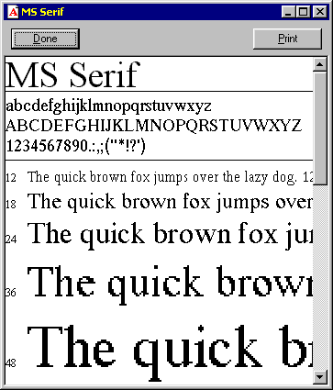
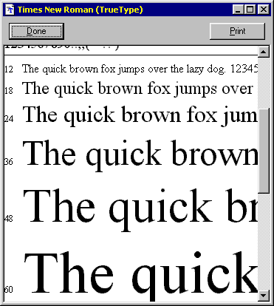
Bitmapped and vector fonts
A bitmapped font
A vector font

Slide 17
Jaggies and Antialiasing
Jaggies are the jagged edges you see when a bitmapped image is resized
It is a consequence of the underlying array of pixels from which the image is composed
Antialiasing is a technique that can be used to eliminate jagged edges
It substitutes additional pixels in other colours to fool the brain into thinking it is seeing continuous lines

Slide 18
Jaggies and Antialiasing
The technique is used to blend the font into the background by transitioning the colour from the font colour to background.
This technique minimizes the jagged edges making for a smoother overall appearance.

Slide 19
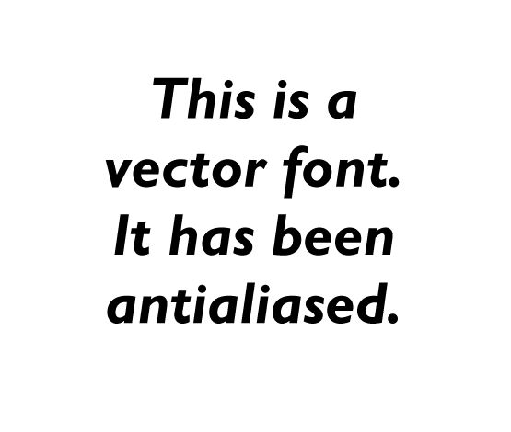

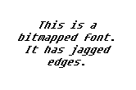

Jaggies and Antialiasing

Slide 20
Text Data Files
The common data encoding schemes for text are:
Plain text (ASCII) is text in an electronic format that can be read and interpreted by humans
Rich text is similar but it also embeds special control characters into the text to provide additional features
Hypertext is an advance on rich text which allows the reader to jump to different sections within the document or even jump to a new document

Slide 21
Text Data Files
Plain text
This is plain text. It is readable by humans. It can contains numbers (01234) and punctuation (.,#@*&) since it uses the ASCII character set.
Rich text
This is <bold>rich text</bold>.<br><center>It is also readable by humans but contains additional tags which control the presentation of the text.</center>
Hypertext
This is <a href=“http://www.w3c.org/”>hypertext</a>. It uses the rich text format shown above but adds the ability to hyperlink to other documents.<hr><img src=“logo.gif”>

Slide 22
Working With Text
Considerations and guidelines when we are working with text:
  Be Concise
  Use the appropriate typefaces and fonts
  Make it readable
  Consider type styles and colors
  Use restraint and be consistent

Slide 23
How text can be used effectively
Communicating Data
- Customer names and address
- Pricing information of products
Explaining concepts and ideas
- A company mission statement
- A comparison of medical procedures
Clarifying other media
- Labels on button, icons and screens
- Captions and callouts for graphics

Slide 24
Advantages and Disadvantages of using texts
Advantages
  Is relatively inexpensive to produce
  Present abstract ideas effectively
  Clarifies other media
  Provides confidentiality
  Is easily changed or updated
Disadvantages
  Is less memorable than other visual media
  Requires more attention from the user than other media
  Can be cumbersome

Slide 25
Summary
Multimedia applications and presentations invariably rely to some extent on the use of text to convey their message to users
Text has many characteristics that the developer can modify to enhance the user experience
  - size, weight, typeface, style, colour, kerning, tracking, etc.
Antialiasing is a technique that can be used to improve the readability of text

Slide 26
Next lecture...
We will looking at images
  The different types of image
  How we capture images
  Generating and editing images

